Slide 1

Überblick Microsoft Cloud Adoption Framework
Azure Landing Zone

Slide 2
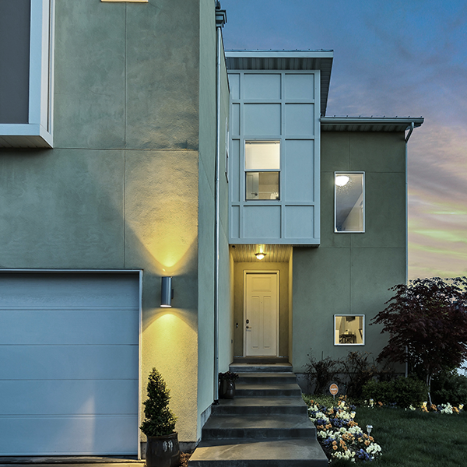
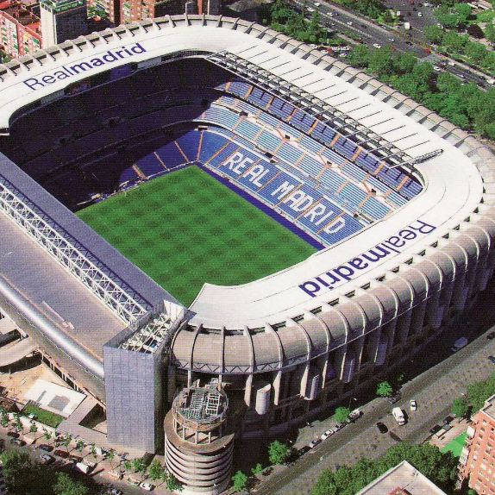

What are you going to build? Your cloud foundation—serves a specific purpose:
A house
A stadium
A bridge

Slide 3
What's the purpose of a landing zone?
Starting a journey with a start-to-finish plan based on best practices is a key factor for success
Creating well-designed foundations for a cloud environment will enable the adoption of new technologies at pace, safely
Using consistent, repeatable environment designs helps scaling out in a manageable way
Baking in best practices into repeatable environments
Considering your team's technical skills as part of environment planning

Slide 4
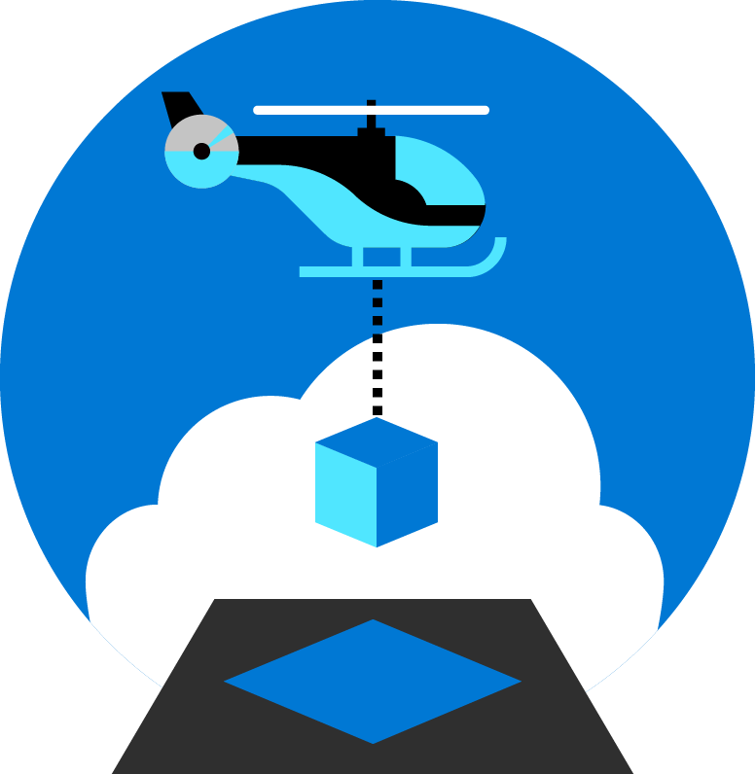
Azure landing zones Help customers set up their Azure environment— for scale, security, governance, networking, and identity
Enable migrations and net new apps
Consider all platform resources
Don't differentiate between IaaS or PaaS

Slide 5



Key challenges
Architecture complexity
Customers lack the required level of understanding and experience on Azure. The mismatch between on-premises infrastructure and cloud-design considerations creates dissonance and friction with respect to defining architectures and standards for their migration to the cloud. They are struggling with the translation of their requirements to Azure concepts, capabilities, constructs and security model.
Operating compatibility
Existing approaches and functions for the traditional delivery and management of IT services are not compatible with the Azure platform and cloud operating models. When combined with a lack of skills and experience, customers are struggling to define and therefore transform their operating model to manage and support large-scale cloud infrastructure.
Lack of trust and desire for control
The absence of a precise and detailed cloud architecture that is compliant with their requirements, and the lack of a well-defined operating model to support such a platform, leads IT not to trust Azure and instead strive to maintain full control. This often involves building ‘walls’ and complicated processes which ultimately get in the way of business lines adopting Azure.

Slide 6
Azure landing zone – Design Areas

Slide 7

Azure landing zones Design areas
Azure billing & Active Directory tenant
Security
Identity & access management
Governance
ENVIRONMENT
COMPLIANCE
Resource organization
Management
Network topology & connectivity
Platform automation & DevOps

Slide 8
Landing zone development approach

Slide 9
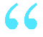

Assess the stage of your cloud journey
Start
Align
Enhance
Build a new environment
informed by best practices and proven architectures
Explore design areas to understand considerations and decisions for your journey
Align to the architectures and guidance of Azure Landing Zones if your organization has an existing environment
Follow best practices guidance in Secure, Manage and Govern methodologies—to continue to mature and evolve your Azure environments—and realize the value of cloud-native technologies
We have not deployed anything in Azure, and want a start-to-finish plan based on best practices.
We have environments and landing zones already, but our requirements have changed, and we need to move towards a different type of architecture.
We have environments and landing zones already, using the CAF guidance, and want to continue improving the controls and configuration.

Slide 10
Different starting points on your cloud journey
Start “greenfield”
Align | Enhance
Build a new environment
informed by best practices and proven architectures
Explore design areas to understand considerations and decisions for your journey
We have not deployed anything in Azure, and want a start-to-finish plan based on best practices.
Follow best practices guidance in Secure, Manage and Govern methodologies—to continue to mature and evolve your Azure environments—and realize the value of cloud-native technologies
“brownfield”
We have environments and landing zones already, using the CAF guidance, and want to continue improving the controls and configuration.
Align to the architectures and guidance of Azure Landing Zones if your organization has an existing environment
We have environments and landing zones already, but our requirements have changed, and we need to move towards a different type of architecture.

Slide 11
Azure landing zone deployment options
Azure landing zone accelerator (default option)
Fastest path to the target architecture
Implements environmental design practices
Implements opinionated compliance design best practices
Alternative approaches for customized Azure landing zones
Partner landing zones
Start small landing zones
Enterprise scale landing zones
Created and customized by your implementation partner or managed service partner
Customized to your operations & adoption plans
Evaluate against the conceptual architecture
Start small and enterprise scale options are available for 3rd party configuration tools, specifically HashiCorp Terraform
Rapidly deploy environment design areas, but defer compliance design areas
Accelerates low risk deployments, but increases time to compliance
Ideal for central IT & central operations with controlled adoption flows
Rapidly deploy environment design areas, but defer compliance design areas
Accelerates low risk deployments, but increases time to compliance
Ideal for central IT & central operations with controlled adoption flows

Slide 12
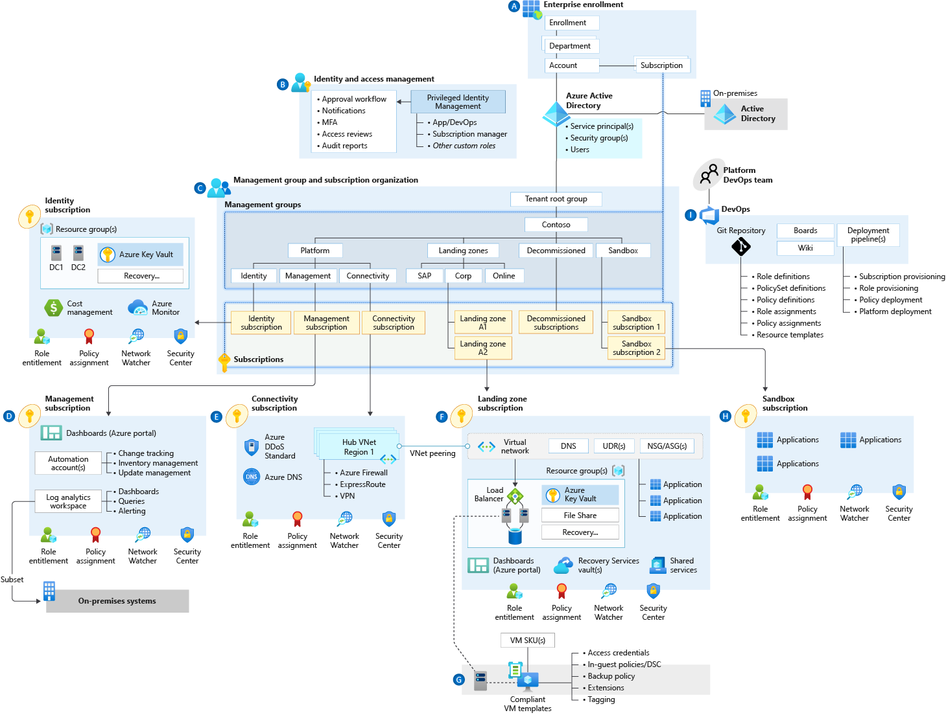
Azure landing zone—conceptual architecture
Target end-state for the majority of organizations
Scaled-out, mature environment
Represents broad range of Microsoft best practices for Azure environment design
Provides strong foundation for organizations to establish on-going management, governance and security processes

Slide 13
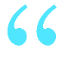

What is "greenfield development"? Organizations developing a new environment without dependencies
At the start of the organization’s cloud adoption journey
New cloud environment
No production workloads deployed
Environment can be overwritten and/or workloads moved without business impact
No business processes impacted by changes to operations, controls or access
We have not deployed anything in Azure and want a start-to-finish plan based on best practices.

Slide 14
Azure landing zones Design areas
Azure billing & Active Directory tenant
Security
Identity & access management
Governance
ENVIRONMENT
COMPLIANCE
Resource organization
Management
Network topology & connectivity
Platform automation & DevOps

Slide 15

Azure landing zones— implementation options
Start with enterprise-scale
Enterprise-scale landing zone
Build a rich initial implementation of landing zones—with fully integrated governance, security, and operations control plane
Understand your motivations and state of the current cloud platform
Validate cloud operating model
Review governance, security, and compliance requirements
Design Azure landing zones—based on design areas
Deploy workloads to Azure

Slide 16


Azure landing zone accelerators Fastest path to deployment
Dedicated subscriptions for specific functions (optional)
Management Group structure
Network topology (hub and spoke or vWAN)
Azure Policy (enforcement options)
Azure Firewall (optional)
Azure Security Center
Azure Defender (optional)
Azure Sentinel (optional)
Azure Network Security Groups (optional)
Azure Monitor (Log Analytics, Audit Logging)

Slide 17
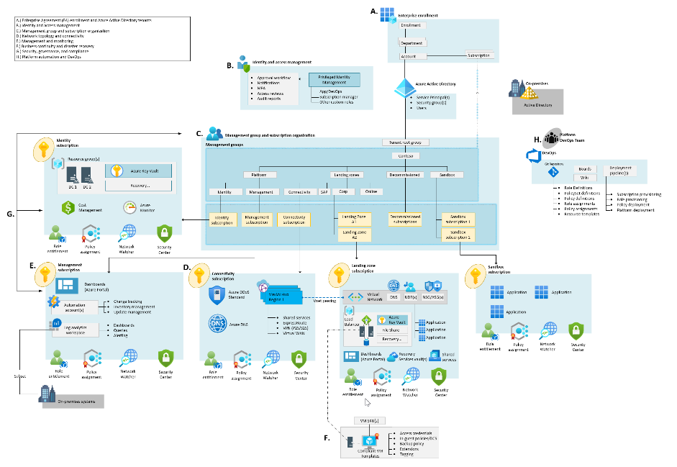






Landing zone implementation options Start small and expand and enterprise-scale
Start small and expand
Deploy w/Azure Blueprints + ARM templates
Start with enterprise-scale
Deploy w/Azure policy + ARM templates
CAF Migrate landing zone
Azure Subscription
Resource Group
Azure virtual network
Azure Active Directory
Storage accounts
Log Analytics
Key Vault
Azure Migrate
Core infrastructure services

Slide 18
What is "brownfield development"? Organizations developing and deploying code in existing environments
Workloads already in use in the cloud
Migration events already executed
Users accessing services in the environment
Production workloads running
We have environments and landing zones already, but our requirements have changed, and we need to move towards a different type of architecture.

Slide 19
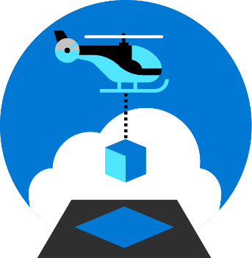
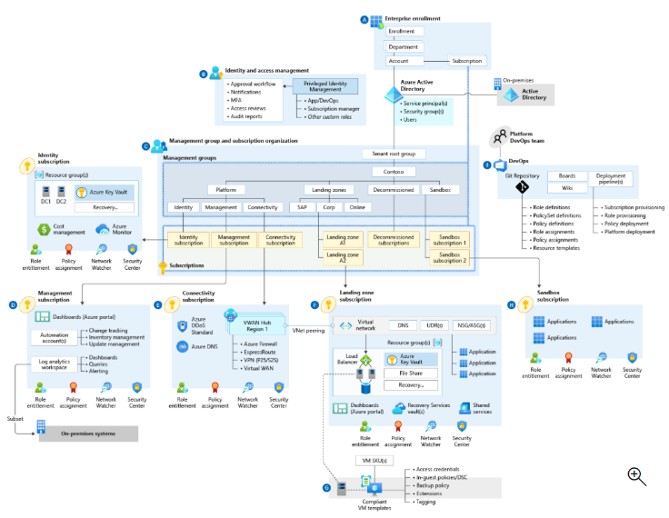
Common approach—landing zone implementation
Target end state:
ALZ conceptual architecture
Check all boxes
Azure billing and AD tenant
Identity and access management
Network topology and connectivity
Resource organization
Governance
Management
Security
Platform automation and DevOps
Check few boxes
Check all boxes
Iterate and check
Small implementation

Slide 20


Architecture—modularity
Core landing zone
Governance
Azure landing zone
Management
Security
Platform automation

Slide 21
Align | Enhance
We have environments and landing zones already, using the CAF guidance, and want to continue improving the controls and configuration.

Slide 22
Azure landing zones— how are they related to the Govern, Manage, and Secure methodologies?
Continue your cloud adoption journey by defining processes for key operational compliance functions
Build on top of the landing zone foundations to enable your organization to scale out services and workloads to meet the needs of the business
Follow the guidance and best practices of the Cloud Adoption Framework methodologies on:
Govern
Manage
Secure

Slide 23
Resources—deployment of cloud-ready environments
Read the Azure landing zones documentation in Microsoft Docs
Learn more about Azure landing zones, and choose the best landing zone option
Implement enterprise-scale landing zones in Azure—and see examples, supported with GitHub resources for implementation guidance

